Slide 1
Factory, Factory Method, Abstract Factory Pattern and SINGLETON
SDA(C & D)

Slide 2
Factory Pattern
In Factory pattern, we create object without exposing the creation logic to the client and refer to newly created object using a common interface.

Slide 3
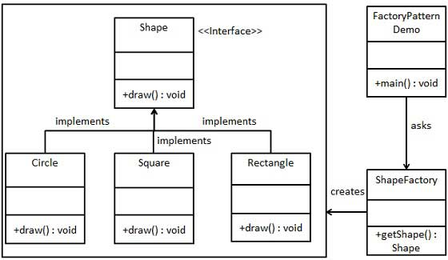
UML for Factory Pattern

Slide 4
Implementation
public class ShapeFactory {
//use getShape method to get object of type shape
public Shape getShape(String shapeType){
if(shapeType == null){
return null;
}
if(shapeType.equalsIgnoreCase("CIRCLE")){
return new Circle();

Slide 5
} else if(shapeType.equalsIgnoreCase("RECTANGLE")){
return new Rectangle();
} else if(shapeType.equalsIgnoreCase("SQUARE")){
return new Square();
}
return null;
}
}

Slide 6
Client Class
public class FactoryPatternDemo {
public static void main(String[] args) {
ShapeFactory shapeFactory = new ShapeFactory();
//get an object of Circle and call its draw method.
Shape shape1 = shapeFactory.getShape("CIRCLE");
//call draw method of Circle
shape1.draw();

Slide 7
//get an object of Rectangle and call its draw method.
Shape shape2 = shapeFactory.getShape("RECTANGLE");
//call draw method of Rectangle
shape2.draw();
//get an object of Square and call its draw method.
Shape shape3 = shapeFactory.getShape("SQUARE");
//call draw method of square
shape3.draw();
}
}

Slide 8
Factory Method
Define an interface for creating an object, but let subclasses decide which class to instantiate. Factory method lets a class defer instantiation to subclasses
Example: Generalizing the relationship between an application and the documents it processes
Generalization: Application creates Documents
Concretized by: MS Paint creates Gifs, MS Word creates Word Documents, MS Excel creates spreadsheets

Slide 9
Design Solution for Factory Method
Factory
factoryMethod()
Product
virtual methods
ConcreteFactory
factoryMethod()
ConcreteProduct
methods

Slide 10
Application-Document Example
Application
createDoc()
Document
virtual methods
MyApplication
createDoc()
MyDocument
methods
return new MyDocument();

Slide 11
Factory Method Consequences
Separation of interface from implementation, providing implementation flexibility
Connects parallel hierarchies for consistency

Slide 12
Abstract Factory
Abstract Factory patterns work around a super-factory which creates other factories. This factory is also called as factory of factories. This type of design pattern comes under creational pattern as this pattern provides one of the best ways to create an object.
In Abstract Factory pattern an interface is responsible for creating a factory of related objects without explicitly specifying their classes. Each generated factory can give the objects as per the Factory pattern.

Slide 13
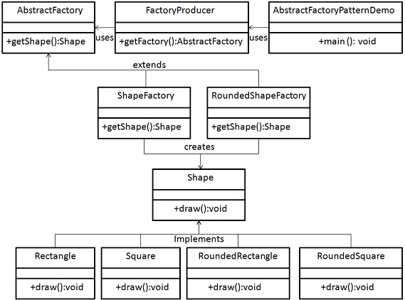

Slide 14
Implementation
public abstract class AbstractFactory {
abstract Shape getShape(String shapeType) ;
}

Slide 15
public class ShapeFactory extends AbstractFactory {
@Override
public Shape getShape(String shapeType){
if(shapeType.equalsIgnoreCase("RECTANGLE")){
return new Rectangle();
}else if(shapeType.equalsIgnoreCase("SQUARE")){
return new Square();
}
return null;
}
}

Slide 16
public class RoundedShapeFactory extends AbstractFactory {
@Override
public Shape getShape(String shapeType){
if(shapeType.equalsIgnoreCase("RECTANGLE")){
return new RoundedRectangle();
}else if(shapeType.equalsIgnoreCase("SQUARE")){
return new RoundedSquare();
}
return null;
}

Slide 17
public class FactoryProducer {
public static AbstractFactory getFactory(boolean rounded){
if(rounded){
return new RoundedShapeFactory();
}else{
return new ShapeFactory();
}
}
}}

Slide 18
public class AbstractFactoryPatternDemo {
public static void main(String[] args) {
//get shape factory
AbstractFactory shapeFactory = FactoryProducer.getFactory(false);
//get an object of Shape Rectangle
Shape shape1 = shapeFactory.getShape("RECTANGLE");
//call draw method of Shape Rectangle
shape1.draw();

Slide 19
SINGLETON PAttern
Singleton pattern is one of the simplest design patterns in Java. This type of design pattern comes under creational pattern as this pattern provides one of the best ways to create an object.
This pattern involves a single class which is responsible to create an object while making sure that only single object gets created. This class provides a way to access its only object which can be accessed directly without need to instantiate the object of the class.

Slide 20
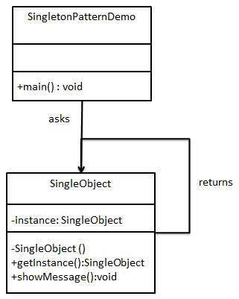

Slide 21
public class SingleObject {
//create an object of SingleObject
private static SingleObject instance = new SingleObject();
//make the constructor private so that this class cannot be
//instantiated
private SingleObject(){}

Slide 22
//Get the only object available
public static SingleObject getInstance(){
return instance;
}
public void showMessage(){
System.out.println("Hello World!");
}
}

Slide 23
public class SingletonPatternDemo {
public static void main(String[] args) {
//illegal construct
//Compile Time Error: The constructor SingleObject() is not visible
//SingleObject object = new SingleObject();
//Get the only object available
SingleObject object = SingleObject.getInstance();
//show the message
object.showMessage();
}
}

